Slide 1
Ensuring Grid Reliability
Camilo Serna, Senior Vice President, Strategy and External Engagement
Foro Energético ANDEG
August 21, 2025

Slide 2
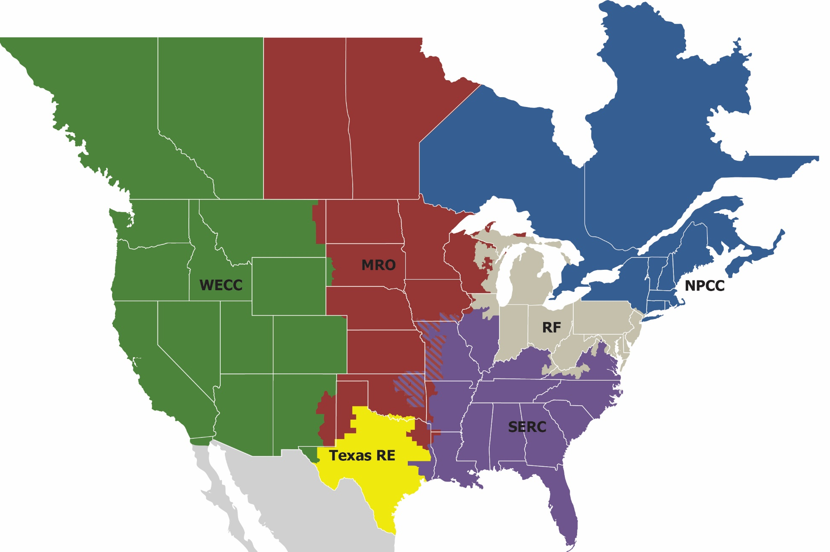
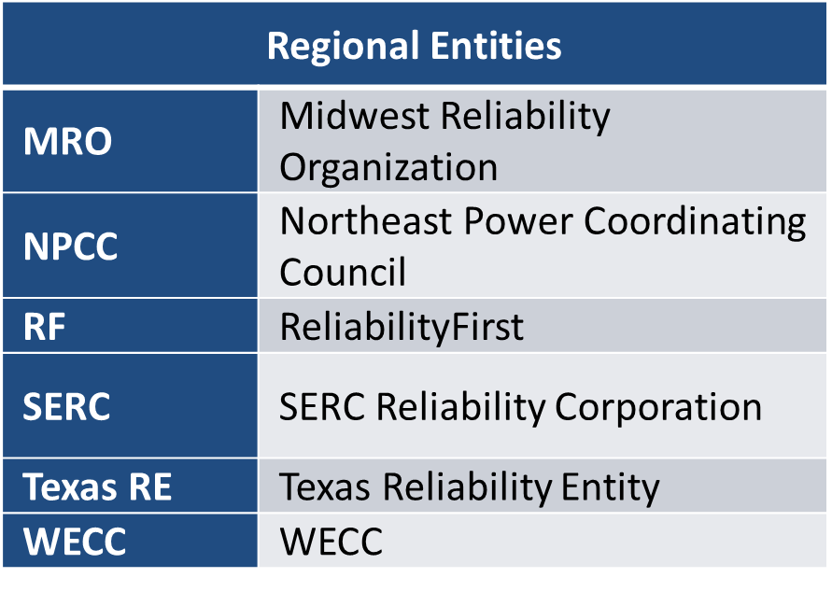
Our Vision & Structure
The vision for the Electric Reliability Organization (ERO), which is comprised of NERC and the six Regional Entities, is a highly reliable and secure North American Bulk Power System (BPS) As the ERO, we are accountable to regulators in the United States (Federal Energy Regulatory Commission - FERC) and Canada (Canada Energy Regulator (CER) and provincial governments)

Slide 3
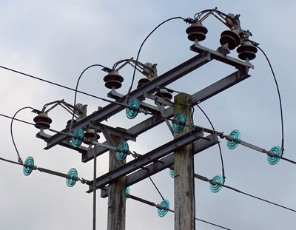
Our Mission
NERC’s mission is to assure the effective and efficient reduction of risks to the reliability and security of the North American bulk power system

Slide 4
NERC’s History
November 9, 1965 – Northeast Blackout​
1968: National Electric Reliability Council (NERC) established by the electric industry​
2002: NERC operating policy and planning standards became mandatory and enforceable in Ontario, Canada​
August 14, 2003 – Blackout​
2005: United States Energy Policy Act of 2005 creates the Electric Reliability Organization (ERO) ​
2006: Federal Energy Regulatory Commission (FERC) certified NERC as the ERO; Memorandum of Understanding (MOUs) with some Canadian Provinces​
2007: North American Electric Reliability Council became the North American Electric Reliability Corporation (NERC)​

Slide 5
NERC’s Activities
Propose, monitor compliance with, and enforce mandatory reliability standards for the North American bulk power system (BPS), subject to regulatory oversight and approvals of FERC in the Unites States and applicable authorities in Canada
Conduct near-term and long-term assessments of the reliability and future adequacy of the North American BPS
Certify BPS operators as having and maintaining the necessary knowledge and skills ​
Maintain situational awareness of events and conditions that may threaten reliability

Slide 6




Risk Assessment
Performance Analysis
Event
Analysis
Situational Awareness
Reliability Assessments

Slide 7

Risk Mitigation
Reliability Risk Mitigation Toolkit
Reliability Guidelines
Reliability Standards
NERC Alert Levels 2 & 3
Reliability Assessments
Risk Impact
Technical Engagement
NERC Alert Level 1
Risk Likelihood
Risk Management Initiation Timeframe

Slide 8
Recent Assessment Findings
Over half of North America is at risk of energy shortfalls over the next 10 years
Demand growth is rising rapidly driven by electrification, data centers, and industrial load
Interconnection queues are robust, dominated by weather-dependent resources
The criticality of the natural gas system to support electric demand swings intensifies
Projected generator retirements remain at significant high levels

Slide 9
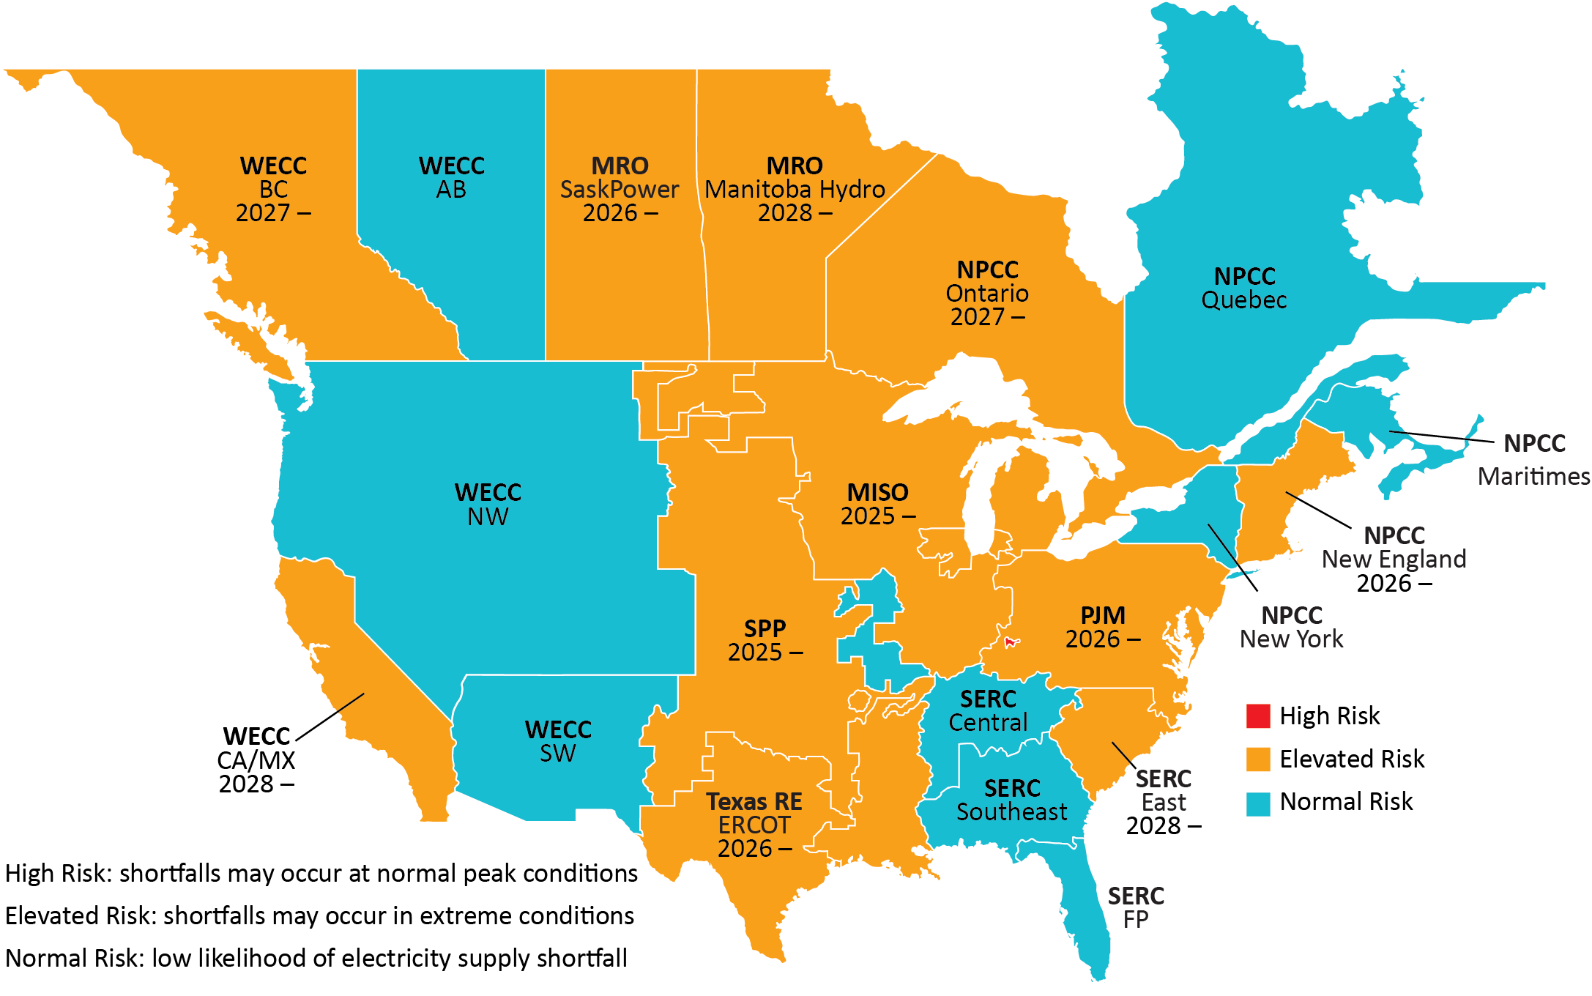
Risk of Energy Shortfalls
Limited Imports in Extreme Cold Weather
Demand Growth
High Risk – Shortfalls may occur at normal peak conditions
Elevated Risk – Shortfalls may occur in extreme conditions
Normal Risk – Low likelihood of electricity supply shortfall
Note: Risk Determination using established resource adequacy criteria (1-day-in-10 years) and National Academy of Engineering Report Criteria for load-loss and unserved energy
Generator Retirements
Limited Dispatchable Generation
Notes:
Big risks and trends from the LTRA’s energy and capacity assessment

Slide 10
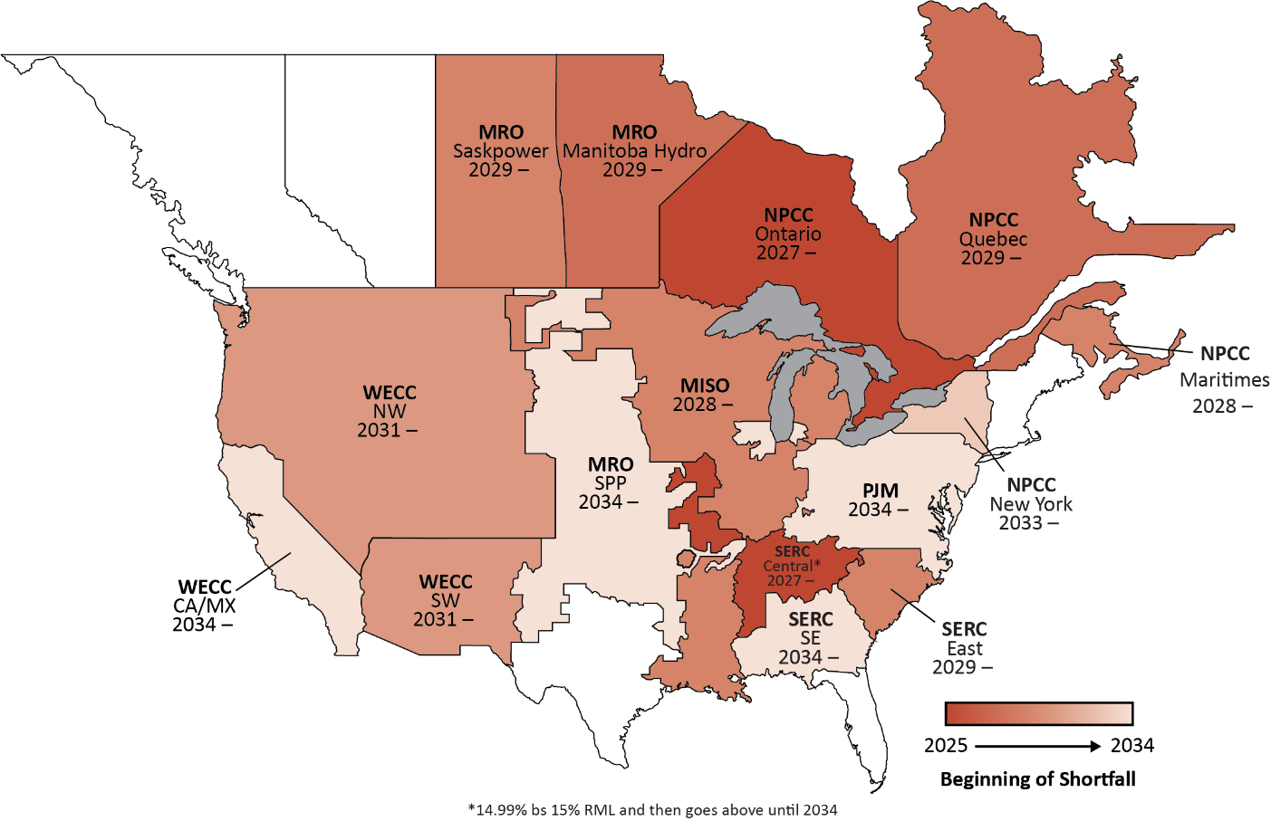
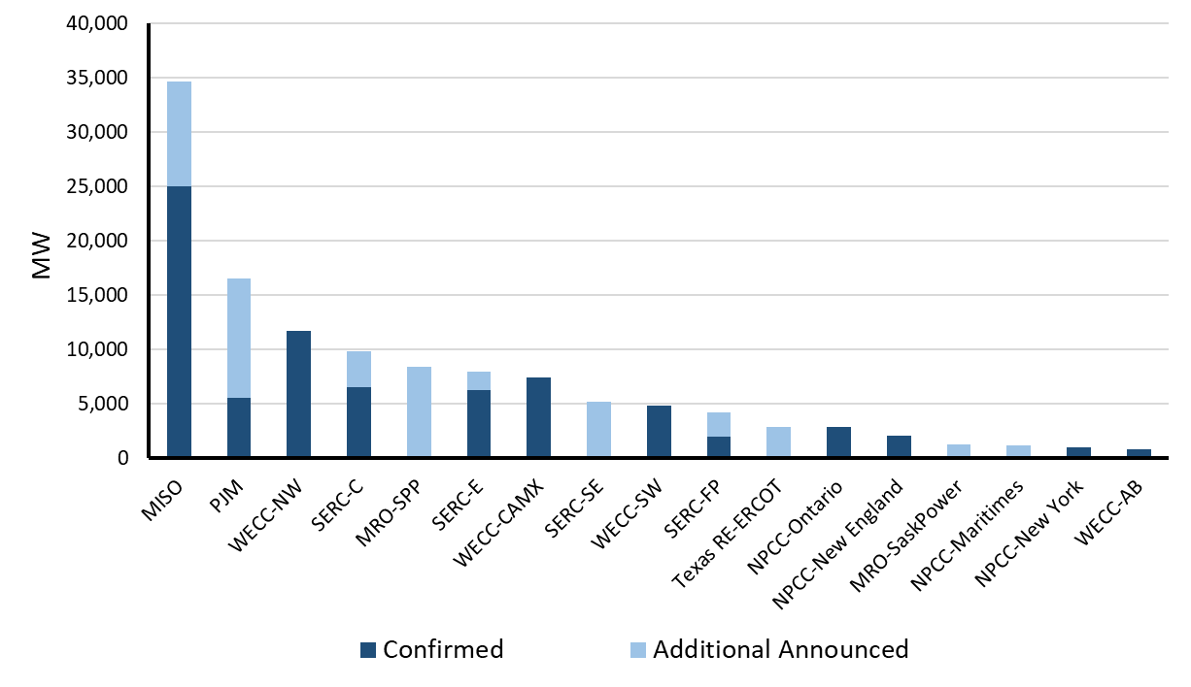
Significant Projected Generator Retirements
Fossil-fired and Nuclear Generator Retirements by 2034 by Region
Reserve Margin Shortfall Projections Over the 10-Year Period
115 GW of expected thermal generator retirements through 2034 (78 GW confirmed; 37 GW announced)

Slide 11
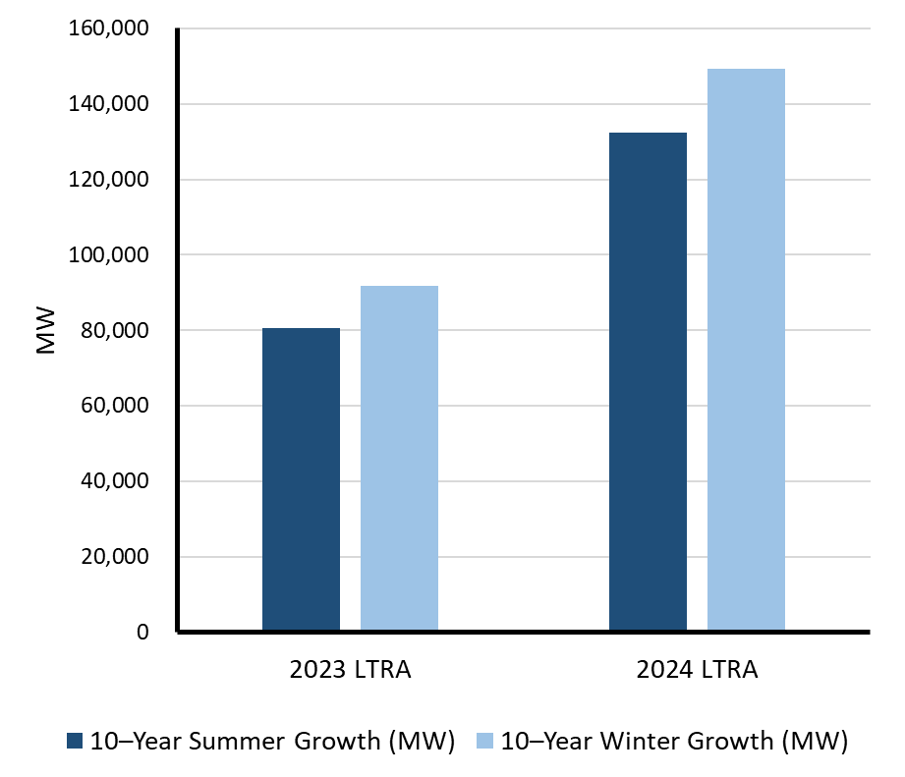
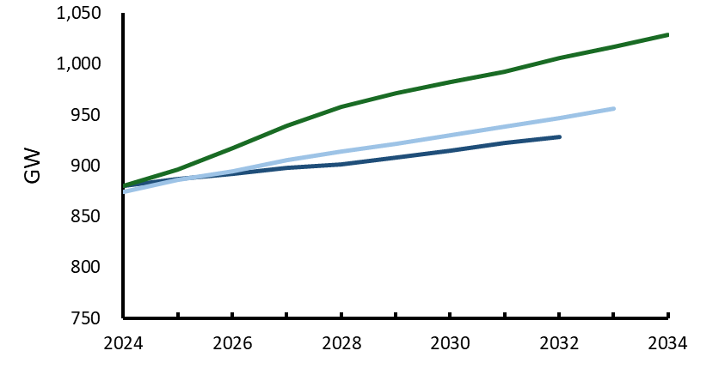
Demand Growth Is Accelerating
10-Year Bulk Power System Peak Demand Growth
10-Year Peak Demand Growth
2024 LTRA 15% Growth
2023 LTRA 9% Growth
2022 LTRA 6% Growth
134 GW of summer peak demand growth; 149 GW of winter peak demand growth. In 2024 only 8 GWs of net peak demand were installed
Notes:
Demand continues to be a big focus for the long-term. Looking at 2023, the 10-year peak demand was increasing at the highest rate in last three decades. Further growth was projected in part due to increases in electrification and EV adoption. Now in 2024’s early look, we see Peak demand growth is increasing at an even higher rate than in 2023 and 2024 records the highest CAGR in the last 20 years. Lots of this increased growth in demand can be attributed to data centers, large commercial and industrial loads, vehicle electrification, and heat pumps showcasing as the predominant drivers. NERC is studying the impacts on some of these new demand drivers, such as large commercial and industrial loads. A new RSTC task force has been created to address this.

Slide 12
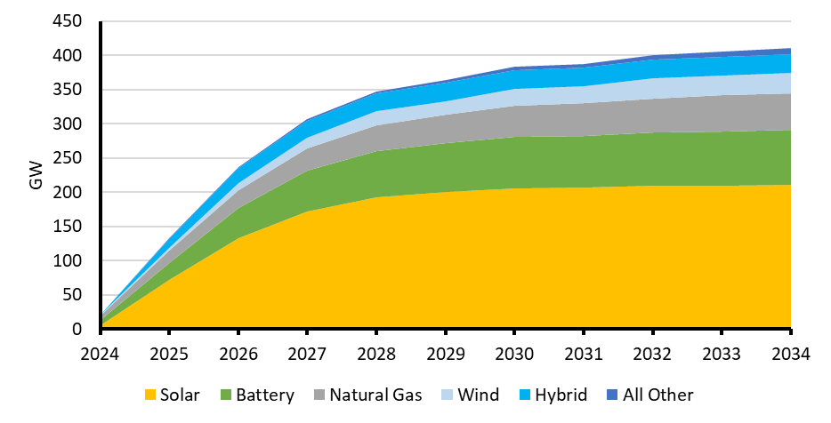
Weather Dependent Resources Dominate Queues
Resources in Interconnection Process Includes Tier 1 (Signed Agreements) and Tier 2 (Processing)
June 6, 2023 Wind Production North American Mid Continent
60 GW
25 GW
10 GW
300 MW
Installed
ELCC*
Operating
*ELCC is essentially the planning value of installed capacity (“Equivalent Load carrying Capacity)

Slide 13
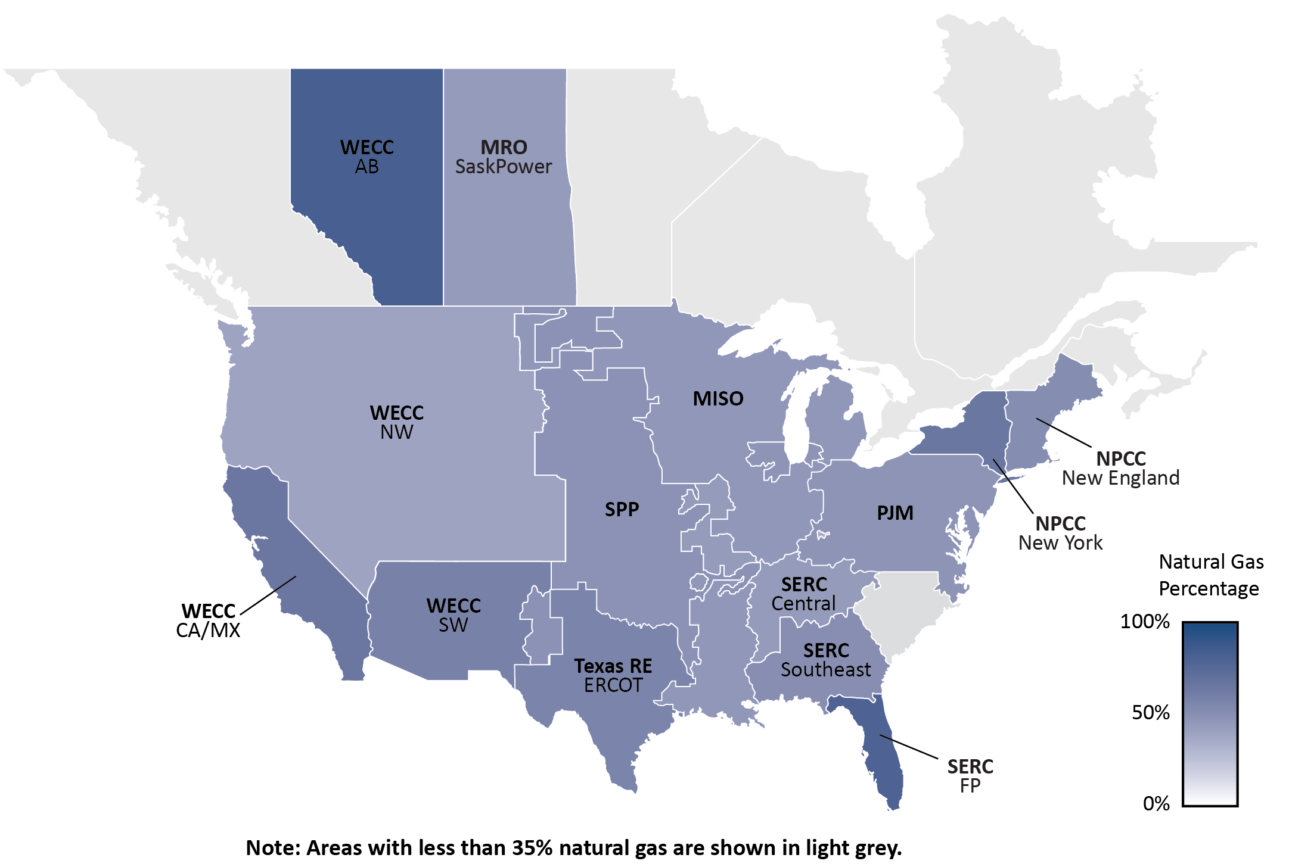
Criticality of Natural Gas Intensifies

Slide 14
Risks Headline
Grid
Load
Resource
RISKS - HEADLINE
Substantive simultaneous change in all Bulk Power System (BPS) dimensions (resource, load, grid), along with increasing complexity in their interactions, requires rethinking traditional planning and operating paradigms, strengthening interdependency awareness, and speed of implementing new approaches to ensure ongoing reliability

Slide 15
Additional Risk Themes
Larger scale BPS reliability impact events are being observed, with contributions from grid transformation effects and increased incidence of large weather system scope, severity, and duration
Natural gas is currently the most critical dispatchable resource, with increasing risk attributes associated with just in time delivery, demonstrated reliability and security challenges, and inability to scale quickly
Security complexities and BPS attractiveness as a target continue to increase
Persistent supply chain challenges are impacting risk mitigation and response capability
A volatile and disconnected policy landscape further complicates the ability to mitigate these risks promptly and effectively through policy solutions

Slide 16

Headline Mitigation Strategy
Grid
Load
Resource
MITIGATION STRATEGY HEADLINE
To deliver ongoing BPS reliability in a time of increasing change and complexity, “more” is required:
More system margin through infrastructure investment
More comprehensive studies and assessments
More coordination
More preparation
More speed in implementing necessary measures

Slide 17
Key Mitigation Strategies
Act now in response to significant energy ecosystem change already underway
Update the planning and operating models, study paradigms, and reliability criteria to better match emerging BPS attributes
Improve the diversity of dispatchable resources and add additional online and responsive sources of essential reliability services
Enhance event mitigation and recovery plans through drills, pre-positioned resources, and stronger cross-sector coordination frameworks
Promote resilient infrastructure investment, and close regulatory gaps in natural gas systems to address the reliability policy implications
Notes:
Discussion: How do we take disparate technologies and create a very tasty soup that is a) clean, b) affordable, and c) secure and reliable
Tatiana Vedeneva — Renewables
King Lee — Nuclear
Vladimir Budinsky — Fossil
Antoine herzog — Storage
I’ll conclude with thoughts on demand side management

Slide 18
Iberian Blackout - Primary Contributing Factors
Iberian Peninsula Blackout
Poor Voltage Ride-through Performance of Resources
Insufficient Dynamic Voltage Regulation
Unreliable Voltage Regulation of Conventional Generators
Potential gaps in Operations Planning

Slide 19
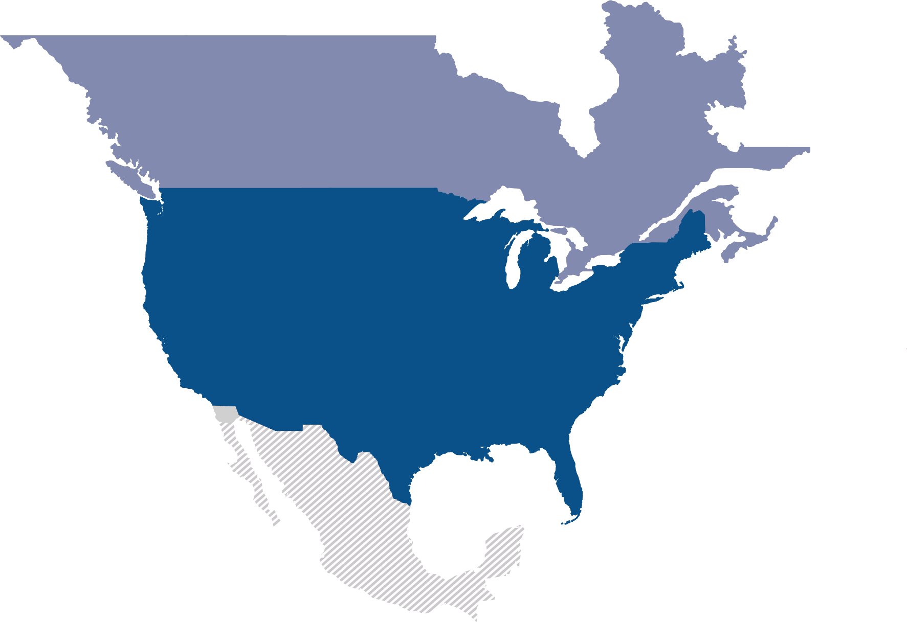
Questions/Feedback?

